Slide 1
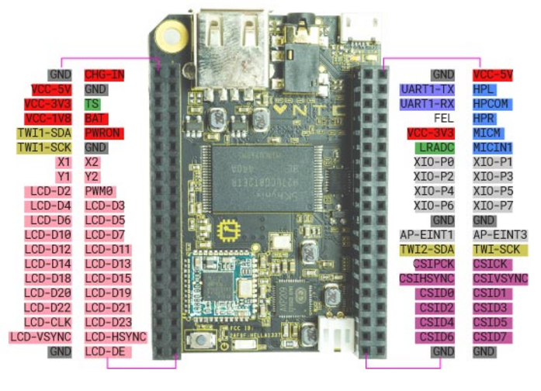
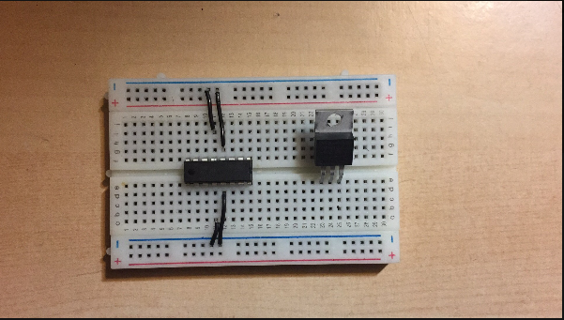
Ground
motor
out
Enable1
Vss
Intput2
Intput1

Slide 2
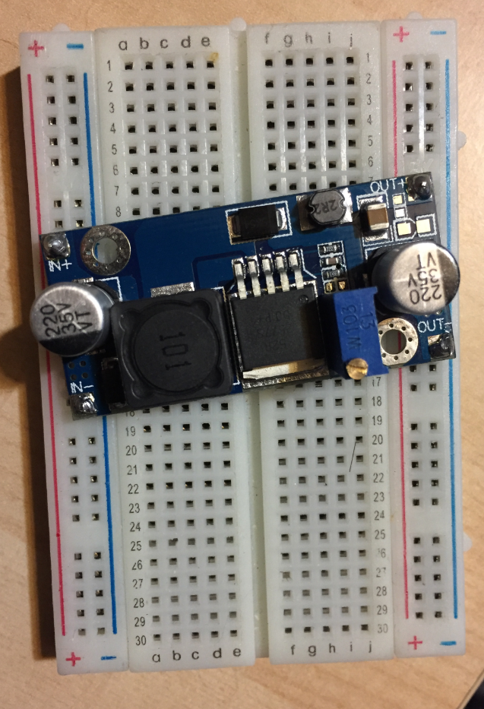
Out+
Out
USB Power
Gn
In
Vss
Out-
USB Power

Slide 3
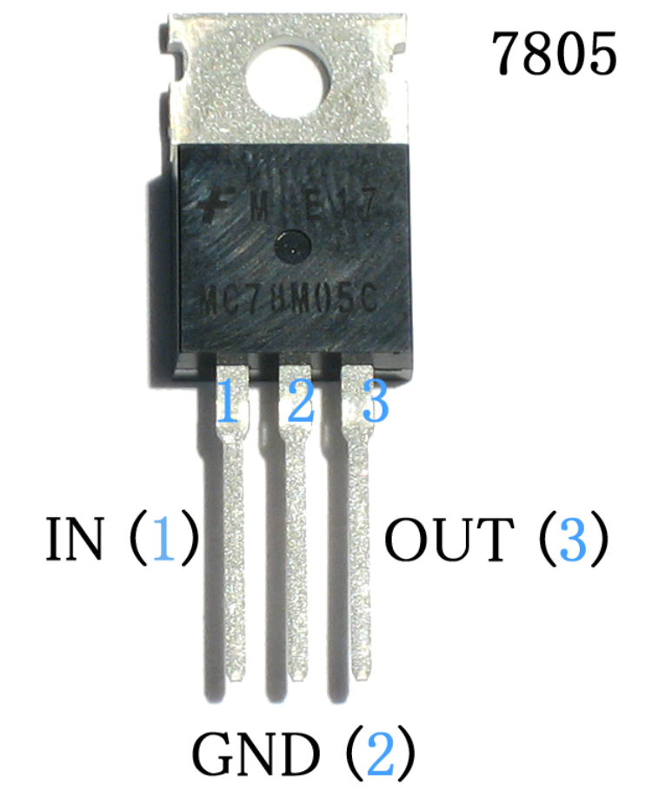

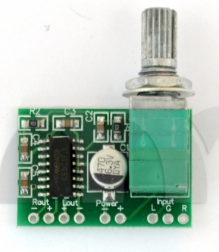
HP L
GND
Out
GND
Speaker

Slide 4


